Slide 1

Electrical Machinery Fundamentals
EE 250 SPRING 2020
Lecture 5
1

Slide 2
Chapter 7 Active, Reactive and Apparent Power

Slide 3
7.1 Instantaneous power
Instantaneous power=
Instantaneous voltage * Instantaneous current
Measured in watts
Positive instantaneous power => Flows into the device
Negative instantaneous power => Flows out of the device

Slide 4
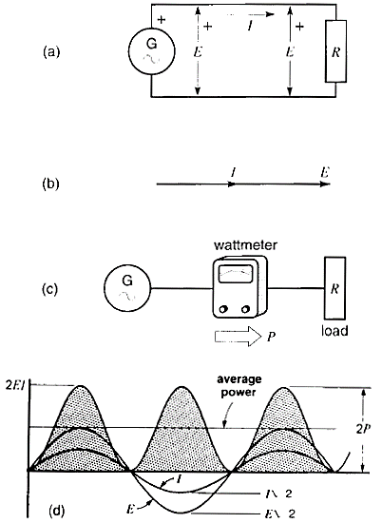
7.2 Active power
Resistive circuit => E and I are in phase
Effective voltage and current are indicated as E and I
Wattmeter connected to measure the power
Peak values of waveforms are E√2 & I√2
Multiply instantaneous value of voltage and current to get instantaneous power (in watts)

Slide 5
7.2 Active power
Power consist of peaks from zero to maximum (2EI=2P)
Positive power reveals that power always flows from generator to load R and we call it active power and it never changes direction (indicated by P in fig.c)
Average power = P = EI
Generator is active source
Resistor is active load
Active power is denoted by P and unit is W, kW, MW

Slide 6
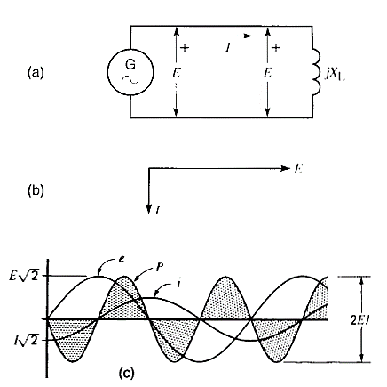
7.3 Reactive power
R is replaced by reactor X_{L} => I lags behind the E by 90°
Effective voltage and current are indicated as E and I
Peak values of waveforms are E√2 & I√2
Multiply instantaneous value of voltage and current to get instantaneous power (in watts)
Power consist of series of identical positive and negative pulses (2EI=2P)
Positive pulses: Power delivered by Generator to Reactor
Negative pulse: Power delivered by Reactor to Generator
This back and forth surges of power is called Reactive Power
Energy in Joules

Slide 7
7.3 Reactive power
Power frequency is twice as that of E an I
Average power = P = EI
Active power is denoted by Q and unit is var, kvar, Mvar
Varmeters are used to measure the reactive power => Q=EI sin φ where E and I must not be in phase or 180° out of phase
Energy flows back and forth because magnetic energy is alternately being stored and released by the reactor
Energy in Joules

Slide 8
7.4 Definition of reactive load and reactive source
Power oscillates between two devices over a transmission lines
Difficult to say weather power is generated at one end or other
We can say some devices generates reactive power (Reactive Sources) while other (Reactive Loads) absorbs it.

Slide 9
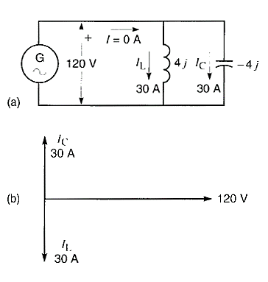
7.5 The Capacitor and reactive power
Adding a capacitor to the circuit that draws 120/4=30A current (leads voltage by 90°)
Vector sum of I_{L} & I_{c} is zero => AC generator is no longer supplying any power at all to the circuit
Inductor continues to absorb 30*120=3.6 kvar of power => This power is coming from capacitor (source of reactive power)
The reactive power delivered by capacitor: Q= 120*30= 3.6 kvar
Conclusion: Capacitor is and will source of reactive power whenever it will be a part of sine-wave-based, steady-state circuit

Slide 10
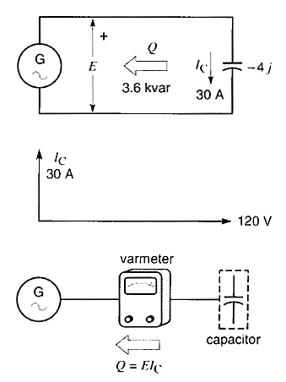
7.5 The Capacitor and reactive power
Now remove the inductor from the circuit
Capacitor alone is connected across generator terminal and carries 30A current (Leading E by 90°)
Again capacitor is delivering 3.6kvar reactive power
Now this reactor power is being delivered to the generator
This is difficult to believe but it happens!!
Pendulum swings back and forth without doing any useful work, same is the case here with capacitor
Capacitor acts as temporary energy-storing device:
Stores energy for a short period of time and releasing it again
Reactive power flows from capacitor to generator (Reactive Load)
Capacitive reactance always generates reactive power

Slide 11
7.6 Distinction between active and reactive power
One can not be converted into other
Can be treated as separate quantities in electrical circuits because they function independently
Active power: Produces heat, mechanical power, light etc.
Reactive power: Represents power that oscillates back and forth
AC inductive devices (magnets, transformers, induction motors etc.) absorb reactive power because one component of current they draw lags behind the voltage by 90°
Reactive power produces AC magnetic field in these devices (Important role of reactive power)
Huge active/reactive load: Shopping mall , Building , City etc. These loads draws both active power (to carry out useful work) and reactive power (to sustain their magnetic field)

Slide 12
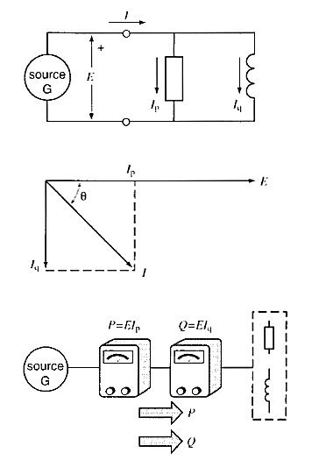
7.7 Combined active and reactive loads : Apparent power
Loads absorbs both active and reactive power and may be considered to made up of resistor and inductive reactor as shown in fig.
Resistor (Active load) draws I_{p} (In phase with E) and inductive reactor (Reactive load) draws I_{q} (Lags behind E by 90°)
Resultant line current I lags behind E by θ and I is given as:
We use wattmeter and varmeter to measure active and reactive power respectively and ampere meter to measure line current
Combination of active power (P) and reactive power (Q) is called apparent power (S), apparent power is measured in volt-amperes

Slide 13
7.8 Relationship between P, Q and S
Line current I lags behind E by θ where I is composed of two components i.e. I_{p} (In phase with E) & I_{q} (Lags behind E by 90°)
From phasor diagram: => =>
Value of angle θ can be calculated as:

Slide 14
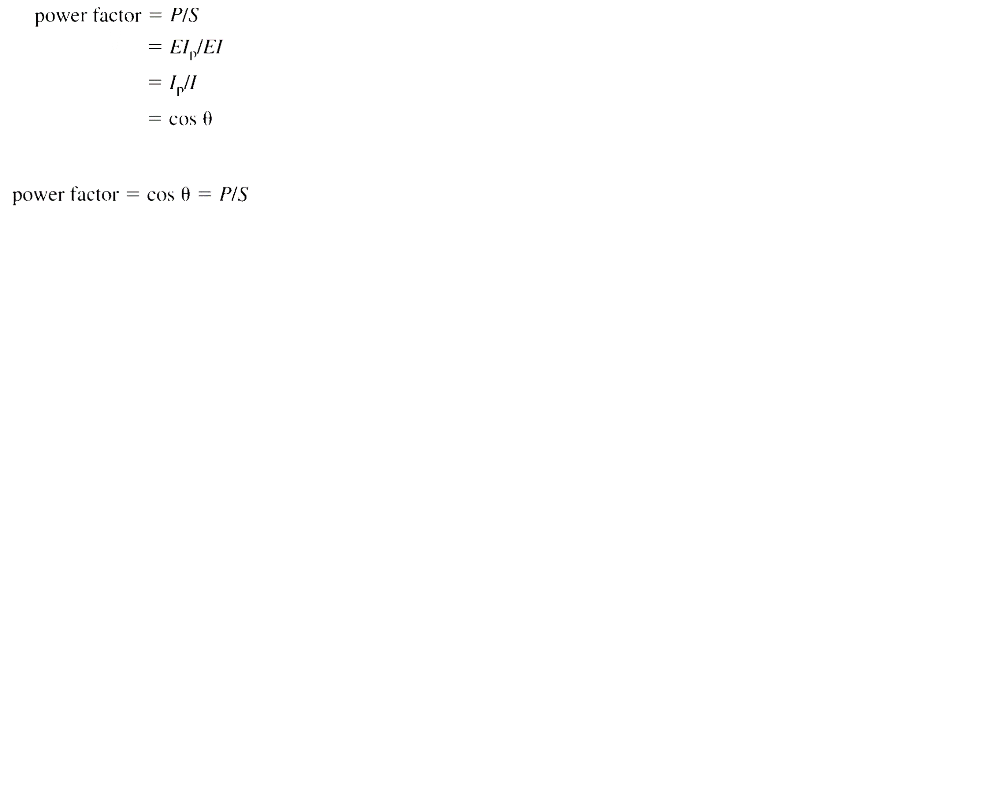
7.9 Power factor
Ratio of active power to apparent power, expressed as a simple number or as a percentage
Power factor can never be more than unity or 100% because P(active power) can never exceed S(apparent power)
Power factor of resistor is 100% because S(apparent power) it draws is equal to P(active power)
Power factor of an ideal coil with no resistance is zero because P(active power) is zero
Power factor is also a measure of phase angle θ between E and I
Power factor is said to be lagging if current lags behind the voltage and vise versa

Slide 15
7.10 Power Triangle
We show relationship between S,P and Q by means of power triangle
Following are the rules for drawing power triangle:
Active power absorbed by a circuit is considered to be positive and drawn horizontally to right
Active power that is delivered by a circuit is considered to be negative and drawn horizontally to left
Reactive power absorbed by a circuit is considered to be positive and drawn vertically to upwards
Reactive power that is delivered by a circuit is considered to be negative and drawn vertically to downwards
In power triangle the components S,P and Q are not phasors

Slide 16
7.11 Further aspects of sources and loads
P is not same as that of Q and each flows independently of other
An electrical outlet can act in both ways:
Active or reactive source
Active or reactive load
This all depends upon the type of device connected to receptacle (socket)

Slide 17
7.12 System comprising several loads
Concept of active and reactive loads enables us to simply the solution of complex circuits
We have to calculate the apparent power absorbed by the circuit and current supplied by the source
We don’t have to worry about the way loads are interconnected
Draw the block diagram of individual loads indicating the direction (as far as the source is concerned) of active and reactive power flow
Distinct nature of active and reactive power enables us:
To add all active powers in circuit to get total active power P
To add all reactive powers in circuit to get total active power Q
Then we find resultant apparent power S as follows:
When adding reactive power:
Assign positive value to those absorbed by the system
Assign negative value to those generated by the system
Same is the case for active power

Slide 18
7.12 System comprising several loads
Lets solve the circuit of previous slide:
Active power absorbed by the system= P = 2+8+14 = +24 kW
Reactive power absorbed by the system= Q₁ = 5+7+8 = +20 kvar
Reactive power supplied by the system= Q₂ = -9-16 = -25 kvar
Net reactive power= Q = +20-25 = -5 kvar
Apparent power = S = √ (24)²+(-5)² = 24.5 kVA
As source furnishes the apparent power so: I = S/E =24500/380 = 64.5 A
Power factor of the system = cos Φ_{L} = P/S = 24/24.5 = 0.979 leading/lagging?
380V source delivers 24 kW active power and receives 5 kvar of reactive power
Power triangle is shown that shows resultant power

Slide 19
7.12 System comprising several loads

Slide 20
7.14 Solving AC circuits using the power triangle method
Active and reactive powers can be added algebraically
Power triangle method enables us to solve complex AC circuits without drawing phasor diagram/resorting to vector i, j notation
We use to calculate active and reactive power of the circuit and then deduce corresponding voltage and current
Example : 7.10

Slide 24
Chapter 7 Course
Topic: 7.1-7.14 excluding 7.13
Examples: 7.1-7.13

